Slide 1


Return to onsite working survey results 2020

Slide 2
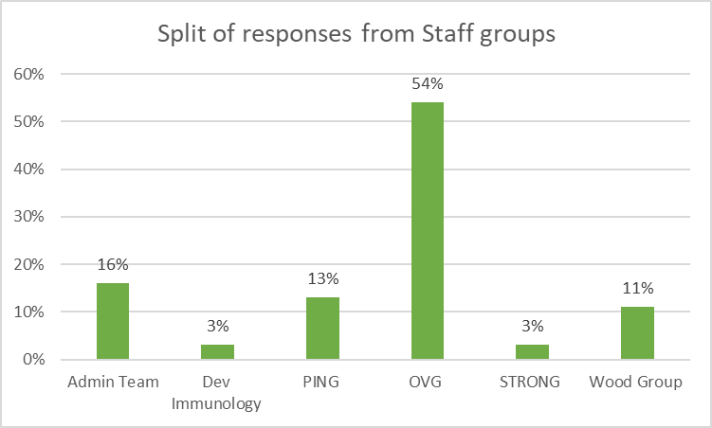
Response Rate
69 people responded out of a department of 180 staff (38% of the staff & student group)
Of the responses the majority were mainly working from home.
The split of responses by staff group is reflective of the demographics of the department

Slide 3
Barriers returning to the office
For those currently working from home, the main barriers that they see in returning to work are concerns about social distancing in work, public transport and childcare issues.
This is reflected in the commentary provided from subsequent questions.

Slide 4
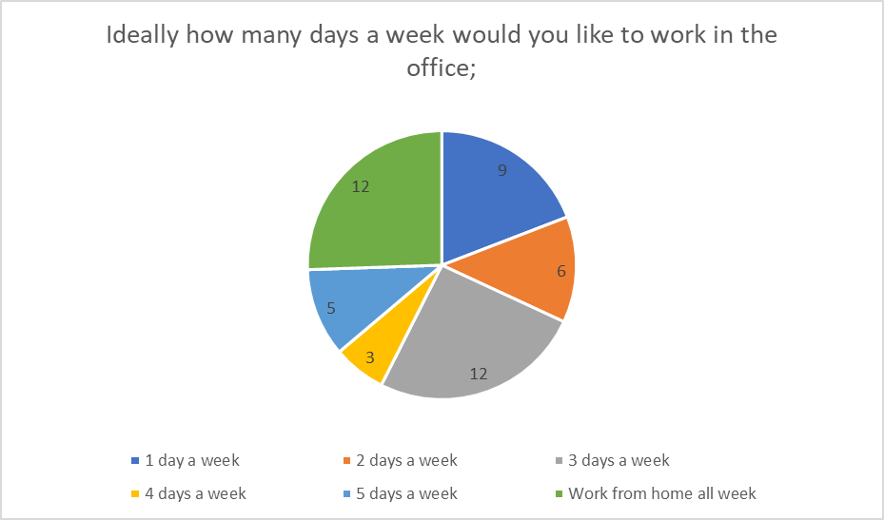
Returning to the office
Of those that are working from home, 57% would prefer to continue working from home, rather than return to on-site working
The majority of staff would like to either work from home all week or 2 days a week
There are benefits from being in the office and some staff don’t enjoy working from home

Slide 5
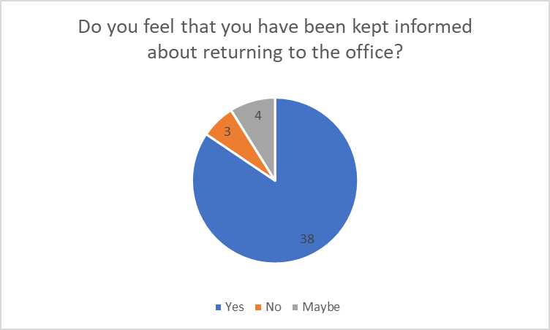
Commentary about returning to the office
Staff feel that they have been keep informed about returning to the office
There are concerns about travelling to work- mainly around using public transport or trying to find somewhere to park
Staff would like to know how long we will be working from home for and if they can work from home more in the future

Slide 6
New ways of working that have been put in place successfully
Flexible working – staff are appreciative of the new flexibility around working patterns and feel that they are working efficiently
Using online meeting systems – useful for staff at different sites and allows flexibility, great way of communicating
Town Hall meetings- they are useful and informative, great way for staff to feel included, respondents would like to continue to have monthly/ termly meetings virtually.
Other areas- modification of social space, making processes e.g. expenses claims/ admin online only, promotion of mental health support

Slide 7
What should we do next?
Circulate support for mental health and ensure managers feel equipped
1
Planning a wellbeing webinar with practical help for staff and managers
2
Keep the Town hall meetings and using online meeting facilities
3
Publicise any information about support for travelling to work
4
Updates about COVID related changes
5

Slide 8

Thank you for taking part in the survey.

