Slide 1
Helen Grieves
Head of Payment Services

Slide 2
Expense Claims

Slide 3






Slide 4

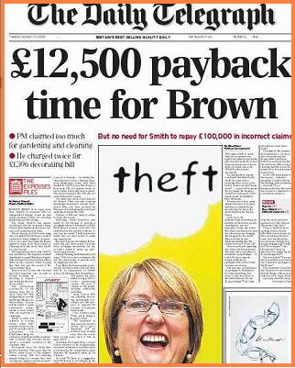

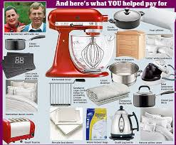

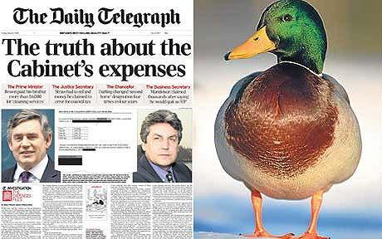
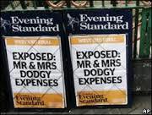
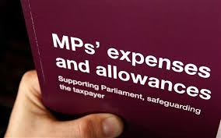

Slide 5

Freedom of Information Requests
6 requests in 3 months last year just on expense claims
Details of amounts paid, number of flights, amounts paid to named individuals, hotel costs etc.
Requests are mainly from reporters

Slide 6
Responsibilities
Claimants and authorisers must ensure that all amounts claimed for reimbursement:
Were incurred wholly, necessarily and exclusively in respect of University business
Comply fully with the rules contained within the Expenses and Benefits Guide
Are supported buy receipts or, in exceptional cases where receipts could not reasonably be obtained, a full explanation
Have been charged to the correct account codes
Do not contravene funding rules where the claim is chargeable to an external funder (eg a research project).
http://www.admin.ox.ac.uk/finance/epp/expenses/guide/

Slide 7
What can be claimed - travel
Use most economic means of travel
Multiple journey tickets (eg oyster card) – need proof of individual trip cost.
Season tickets – only if just for business travel – addition journeys never allowed
Taxis – Unlikely to meet the general requirement for economy – need an explanation as to why such means is necessary

Slide 8
Home phone/Personal mobile
Only business calls identified on a supporting bill can be reimbursed.
Rental charges, data charges, messaging charges etc. are not covered by the dispensation.
Internet access at home
If an employee is submitting a claim for reimbursement, this is not covered by the dispensation.

Slide 9
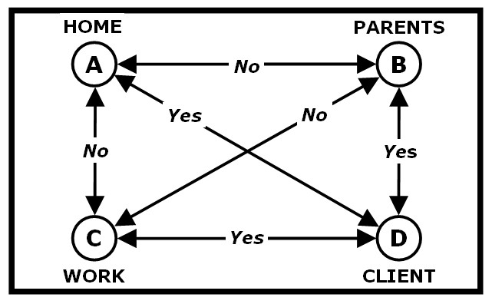
What can be claimed - travel
Notes:
Only if parents to client less then office to client

Slide 10
Business entertaining and Staff entertaining
It is not always clear from a claim form whether business or staff entertaining. The dispensation insists that claims for genuine business entertaining should be supported (albeit at a local level) with records of amount spent, the nature of entertainment, the persons entertained and the reasons for entertainment.
Complete a PSA form if required for staff entertaining

Slide 11
Working meals on University Premises
Covers situations where the integral part of the meeting takes place over a normal meal time and the business of the meeting continues while or immediately after the food is consumed
And
No alcohol
Meal on University premises
Copy of agenda and notes are kept
Working meals elsewhere
As above plus
Must have External speaker or attendee

Slide 12
IT/Telecomms Hardware and Software
Should be bought through central purchasing agreements where possible – cheaper (generally),and avoids tax issues
smartphone apps and ‘cloud’ storage, such as Dropbox. - taxable.
Mobile Phones, Tablets, Laptops
personal property or if it is the property of their employing department? I.e. If they were to leave the University, would they return the device to their department?
Calls – must be itemised supported by an itemised bill

Slide 13
Help us to make it easy
List all receipts on a spreadsheet
Staple invoices to a sheet of paper
Add any additional information you think may be helpful

