Slide 1
Research Services Presentation to
Department of Paediatrics
Gill Rowe
Head, Research Services, Medical Sciences
23 September 2015

Slide 2
Agenda
Research Services Overview
Grants v. Contracts
Grant Applications
Research Contracts

Slide 3
We are part of a wider administrative and professional support network

Slide 4
LAW, FUNDER REQUIREMENTS AND UNIVERSITY POLICIES
Acts of Parliament – Charities, Data Protection, Freedom of Information
Funder requirements – Research integrity, Open Access
Personnel Policies and Procedures
Financial Regulations (inclu. Insurance)
University of Oxford statement of health and safety policy
Intellectual Property Policy
Data Quality Policy
Statement of policy and procedure on conflict of interest
Bribery and Fraud Policy
Information Security Policy
Academic Integrity in Research: Code of Practice and Procedure
Ethical Review for Research Involving Human Participants
Policy on the Management of Research Data and Records
Oxford Open Access Statement

Slide 5
Our responsibilities include
Research Grants Administration
Research Contracts
(Review, draft, negotiate, execute)
Research Development and strategic partnerships
Intellectual Property Rights (Incl. clearances to Isis Innovation)
Research Ethics and Integrity
Support for Academic Planning
Facilitating Knowledge Exchange and Impact
Advice and tools for costing and pricing research
Support for clinical trials
Risk management
Research Information and Systems
Joint review and continuous improvement of services

Slide 7
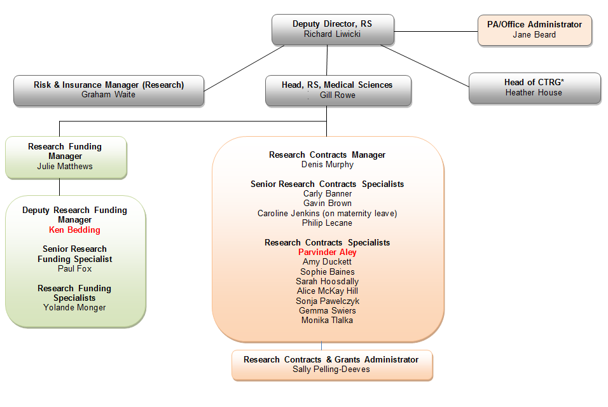
Research Services Medical Sciences
*Clinical Trials & Research Governance

Slide 8
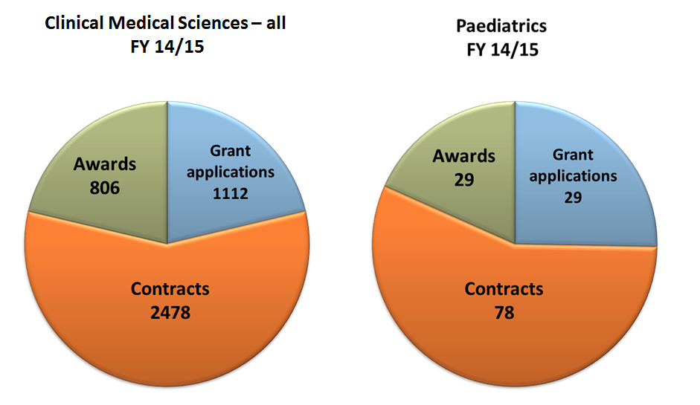

Slide 9
Research Grants v. Research Contracts
Competitive bids for funding
Specific guidance
Deadline driven
Standard contractual terms
Submission systems
University policies
RS institutional signature
Risk management tool
Legally binding agreements
Context specific
Negotiated
Signed by all parties
University policies
RS institutional signature

Slide 10
RS Grant Application – 5 Day Rule
Completed application and X5 costing is required 5 working days before the submission deadline
WHY?

Slide 11
Reasons for RS 5 day rule
(NOTE – This is in addition to the days that Department requires for its own review. For some MRC schemes, NIH and/or where OUH costs are required this will be longer).
Grant applications are a competition
- Funders want reasons to reduce numbers
- WT – ‘A sloppy application = a sloppy scientist’
- Research Councils – ALL submission requirements need to be met.
Reduces risk – financial, reputational, governance
Ensures collaborators are committed to the bid
Allows time to resolve problems
Same rule applies when we are the collaborator.

Slide 12
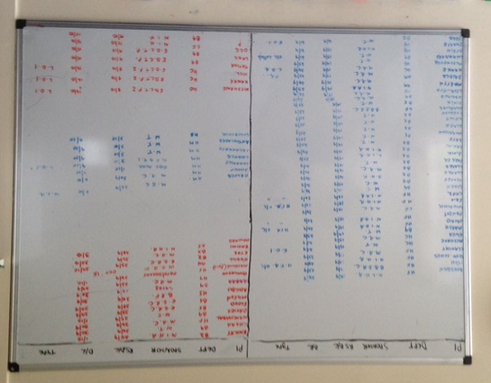
Reasons for RS 5 day rule continued
6. Workload Volume
The more time RS has, the more time there is to submit high quality grant applications and improve success rates (approx 35%)

Slide 13
Research Contracts
Council requirement
Standard templates v. bespoke
Negotiation usual
Getting the terms wrong or ambiguous can:
fetter academics career
result in financial loss
legal disputes
reputational damage

Slide 14
Working together on research contracts
Context of the proposed relationship - tell us if it changes over time
Background information - as much as possible e.g. objectives, parties, patents
Collaborators – clarity on who is doing what eg material transfer
Funding - source and flow
Timelines – realistic expectations
Engage with us early and throughout - ask/answer any questions
Insurance - under 5’s and children/overseas referred to insurer
X5 costing required before contract signature

Slide 15
http://www.admin.ox.ac.uk/researchsupport

