Slide 1
Introduction to Purchasing
Tim Frost
Purchasing Manager (Science & Laboratories)

Slide 2
Collaborative procurement initiatives (incl. liaison with purchasing consortia)
University purchasing policy
Senior management board
Setting functional objectives & performance measures
Managing overarching functional performance & continuous improvement
Embedding category management & supplier relationship management
Embedding supporting systems & processes
Stakeholder management (incl. Research Services)
Head of profession (skills development)
Director of Purchasing
Mark Bowen
Deputy Director of Purchasing
Jo Sibbald
Data categorisation & analysis
Management information design & production
Purchasing process & systems efficiency projects
Purchasing systems super-user
Business partner function (develop pipelines of work, relationship management, issue resolution)
Pilot ‘category management’ projects
SRM with strategic suppliers
Workload & KPI management
Major procurement projects
Promotion of function
Purchasing Manager
Claire Seeley
- Humanities
- Social Sciences
AS (incl. Estates Services)
Museums & Libraries
Purchasing Manager
Tim Frost
- MPLS
Med Sci
Purchasing Analyst
Emma May
Category Buyer
Natalie Sowden
Centralised Estates Services
Category Buyer
Nathan Clulow
Non-Scientific Professional Services, Travel & Telecoms
Category Buyer
Luke Johnson
IT & Commodities
Category Buyer
Christine Aherne
Scientific Equipment & Services
Category
Buyer
Emma Jayne Archer
Scientific Consumables
Project buying (tendering)
Contract & supplier reviews
Contract lets & re-lets
Implement category plans
Lower risk project buying (tendering)
Run customer & supplier performance reviews
Intranet owner
Team support
Assistant Buyer
Lily McMullen
Admin Assistant
Tim Philipson

Slide 3
Why use Preferred Suppliers?
Reduces risk - you are protected
Already agreed to the University’s terms and conditions (deal with important practical issues such as non-delivery, risk in transit)
No hidden charges
A history of trading and an existing relationship with the supplier
Credit referenced and financially vetted
Able to provide management information on your purchases
The University is regarded as a ‘customer of choice’ which gives you more influence over the supplier
Saves you money
Selected on the basis that supplier offers value to the University
Preferential commercial terms agreed by the Purchasing Department
University-wide pricing so that all departments pay the same price (irrespective of order size)
Regular reviews of pricing conducted centrally
Saves you time
No need to trawl the internet for suppliers
Easy to access contact details and pricing (link overleaf)
Multiple quotes not needed for purchases under £25,000 (ex-VAT)
Majority of preferred suppliers trade electronically through Marketplace system

Slide 4
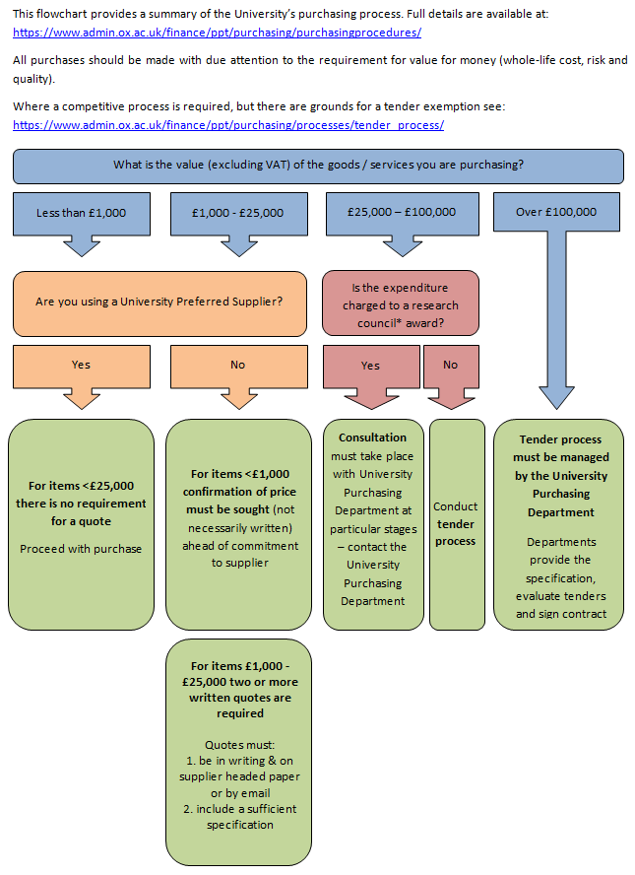
University Financial regulations

Slide 5
Expectations
Grant funding
Welcome Trust
“You must ensure that any equipment funded by the Grant is purchased in accordance with your procurement procedures in a manner that delivers value for money, is used for the Grant Activities, and is adequately maintained and insured for all appropriate risks.”
Research Councils (MRC etc..)
“The procurement of equipment, consumables and services, including maintenance, must comply with all relevant national and EU legislation and the Research Organisation’s own financial policy and procedures. Accepted procurement best practice in the higher education sector must be observed. For all equipment and services where the contract value is more than £25,000, excluding VAT, professionally qualified procurement staff must be consulted before the procurement process begins, and, where appropriate, at the market research stage, and must approve the order/contract before it is placed with a supplier.”
NIH
“Recipients must exercise proper stewardship over Federal funds and ensure that costs charged to awards are allowable, allocable, reasonable, necessary, and consistently applied regardless of the source of funds. NIH may disallow the costs if it determines, through audit or otherwise, that the costs do not meet the tests of allowability, allocability, reasonableness, necessity, and consistency.”
What does this mean to the University?

Slide 6



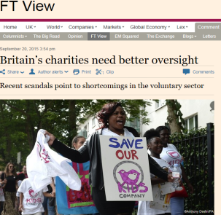
Stewardship
Can you agree/sign a contract?
What about the terms and conditions?
When do I raise a PO and why?
Post purchase issues
Value for money as a concept – hidden charges, your time, effort in bucking process
Plan – lack of time is very rarely an acceptable answer!
Consequences?
Challenge
Litigation
Reputation
Reduction in future funding
Avoidable work, use of resource and cost

Slide 7
Summary
Check websites for processes
If in doubt ask – your own admin team are your first call
Prevention is better than cure
Processes are in place to make life easier!
WE ARE ALL HERE TO HELP

